Slide 1
THE COST
OF CARE
An Analysis of Hospital Markups and Patient Outcomes

Slide 2
Table of Contents
01
02
03
04
Overview
Findings
Conclusion
Dashboard

Slide 3
01
Overview

Slide 4

Key Questions:
Are hospitals with higher costs, charges, and/or markups more likely to achieve lower readmission and mortality rates?
Are hospital size and type related to the costs and quality outcomes?
How do patient satisfaction scores relate to financial measures, hospital categories, and clinical quality metrics?

Slide 5
Definitions
Costs | Costs incurred by the hospital for services
Charges | Charges to the patient for services
Charge / Markup Percentage | Charges as a percentage of costs (e.g. 200% markup is double the cost)
Mortality | CMS Hybrid Hospital-Wide, All Cause Mortality Score (lower is better, ~4.2 avg)
Readmission | CMS Hybrid Hospital-Wide, All Cause Readmission Score (lower is better, 15.0 avg)
Patient Satisfaction Rating | Overall and categorical ratings for hospitals from national patient survey

Slide 6
Methodology
Cleaning and joining 6 CMS datasets
Dashboard for drilling down into details
SQL
Tableau
01
02
03
Python
Analysis, modeling, and visualization

Slide 7
02
Findings

Slide 8
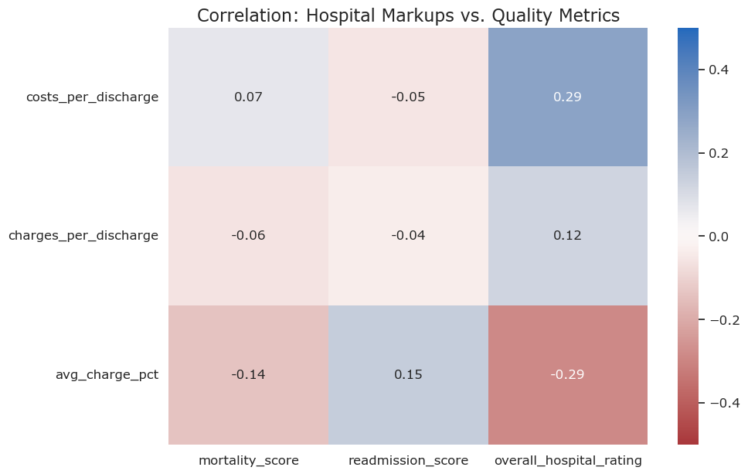
Finding 1: Price is Decoupled from Clinical Safety
Correlation between charge markup percentage and mortality is a negligible −0.14.
Correlation between charge markup percentage and readmissions is a similar 0.15.
Costs and charges show almost no correlation to mortality or readmissions.

Slide 9
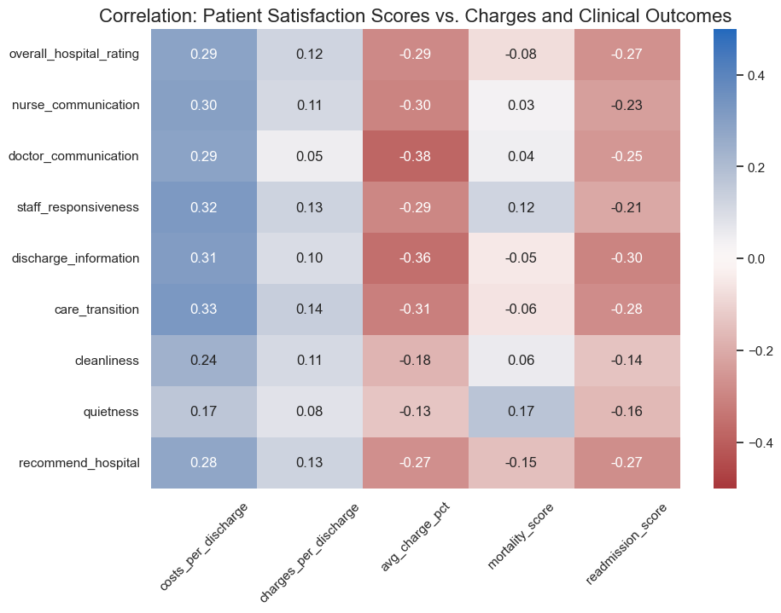
Finding 1 (cont.): Price is Bad for Patient Experience
Higher markups are more closely linked to worse patient satisfaction scores. This is especially true of doctor communication and discharge information with -0.38 and -0.36 correlation to charge markup percentages, respectively.
Costs per discharge have some correlation with higher patient ratings while charges per discharge have only a slight correlation.

Slide 10
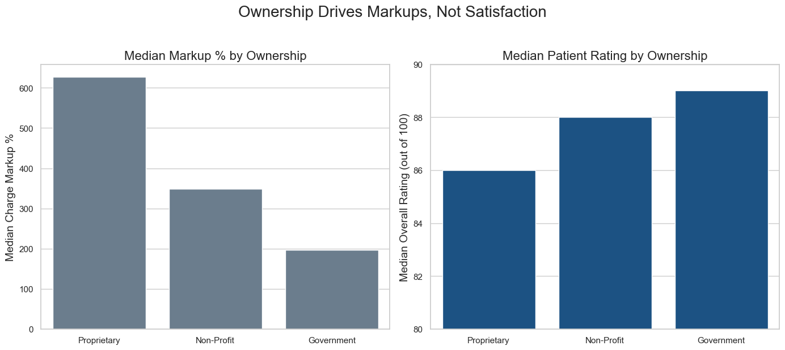
Finding 2: The Primary Driver of Pricing is Ownership
The evidence:
Here’s an assortment of alternative resources whose style fits that of this template:
Hand drawn doctor in hospital background
Flat-hand drawn hospital reception scene

Slide 11
Finding 2 (cont.): High Price =/= Elite Quality
Hospital Name | State | Mortality | Readmission | Patient Rating | Markup %
NYU Langone | NY | 1.8 | 13.1 | 89 | 641.21%
MA General | MA | 2.0 | 14.3 | 93 | 389.62%
NY Presbyterian | NY | 2.2 | 13.6 | 88 | 440.84%
Mayo Clinic Rochester | MN | 2.3 | 13.9 | 94 | 299.76%
Northwestern Memorial | IL | 2.3 | 15.0 | 92 | 591.53%
Brigham and Women’s | MA | 2.3 | 14.9 | 92 | 383.74%
Morristown | NJ | 2.3 | 13.6 | 89 | 511.65%

Slide 12
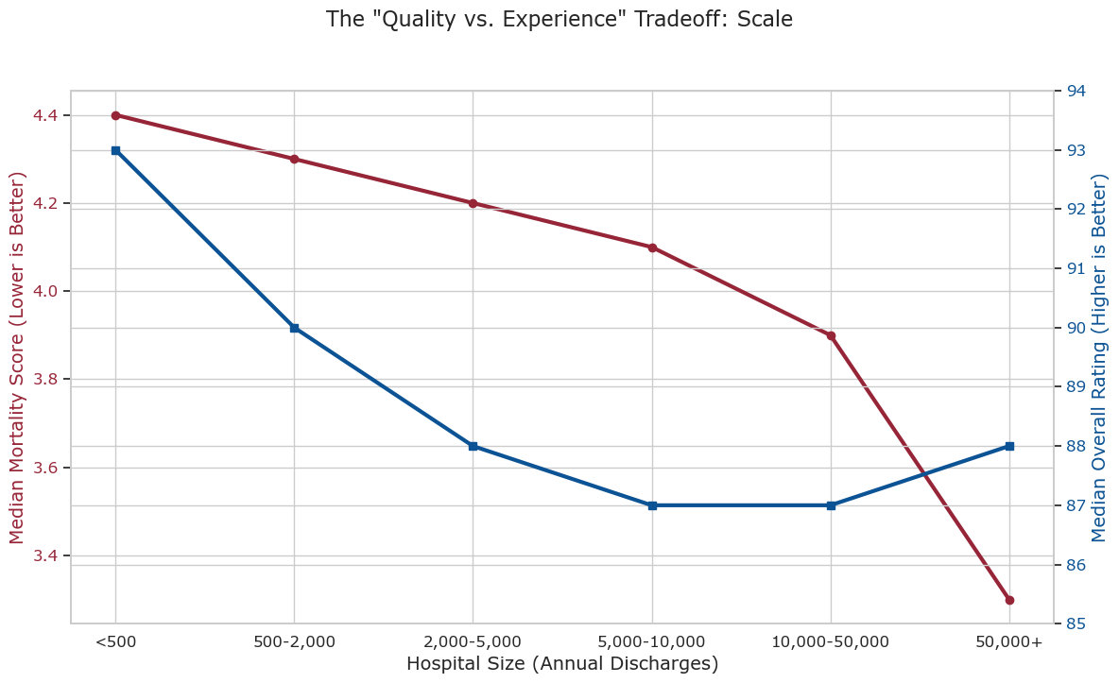
Finding 3: The Real Driver of Quality is Scale
There is some tradeoff between clinical safety and patient experience. Mortality rates are best at the largest hospitals (50,000+ discharges), but patient ratings peak at smaller hospitals.

Slide 13
Finding 3 (cont.): The Real-World Tradeoff
Hospital Name | State | Patient Rating | Readmission | Mortality | Markup %
Unity Medical Center | TN | 98 | 14.8 | 5.1 | 231.85%
Mayo Clinic Hospital | AZ | 97 | 14.1 | 2.6 | 312.13%
Orthopaedic Hospital of WI | WI | 97 | 13.2 | 3.9 | 464.14%
Childress Regional MC | TX | 97 | 14.5 | 4.8 | 234.95%
Physicians Care Surgical Hospital | PA | 97 | 14.0 | 4.1 | 494.48%
Avala | LA | 97 | 14.8 | 4.0 | 657.56%
Miwest Medical Center | IL | 97 | 14.5 | 4.2 | 155.12%

Slide 14

Conclusion

Slide 15
Conclusion
Takeaways:
Price is Decoupled from Quality: Hospital markups are negatively linked to patient satisfaction and are unrelated to clinical safety. Charges largely unrelated to quality while costs and investments align somewhat with increased patient experience.
Ownership Drives Price: For-profit status is the number one predictor of high markups.Flat-hand drawn hospital reception scene.
Scale Drives Quality: Clinical safety is best at the largest hospitals, but patient experience is best at smaller ones.
Recommendations:
Favor non-profit hospitals for cost.
Favor large scale hospitals for complex and life-saving care.

